Slide 1
Word segmentation as a filter on learnable stress systems
Ryan Budnick, UPenn
NECPhon (November 16, 2019)

Slide 2
Outline
Previous related work
Motivation and Mechanism
Discrete-Stress Model
Framework
Case Studies
Typology
Conclusions and Future Directions

Slide 3
Previous related work

Slide 4
Stress and word-boundaries
“Endlich ist die sogenannte ‘unfreie’ oder ‘gebundene’ Betonung
auch ein aphonematisches Grenzsignal.”
[Finally, the so-called “non-free” or “bound” stress
is also a non-phonemic boundary-signal]
Trubetzkoy (1939/1958): 247
Here: Mechanistic explanation through learning; further formalization

Slide 5
Stress and automata theory
Idsardi (2009):
FSA implementations of parametric metrical theory
Reveals underlying simplicity
Heinz (2009):
Automaton-theoretic stress (near?-)universal
Includes a natural learning model
Here: Perception rather than production, with all that comes with it

Slide 6
Stress and learnability
Staubs (2014):
Stress typological frequencies from learning biases
Focuses on MaxEnt HG learners
Stanton (2016):
Explains away gaps in OT typology with learning
Evaluates evidence rareness and ambiguity
Here: Representation-agnostic; learner input is utterances, not words

Slide 7
Motivation and Mechanism

Slide 8
Rhythm and stress are learned early
Birth
4 months
6 months
9 months
Discriminate stress-, syllable-, mora-timed
(Mehler et al., 1988,
Nazzi et al., 1998)
Discriminate trochees from iambs (ERP)
(Friederici et al., 2007)
Discriminate trochees from iambs (behavioral)
(Jusczyk et al., 1993,
Höhle et al., 2009)

Slide 9
Stress is used in early word segmentation
English-learning infants around 7-9 months segment trochees and dactyls from English, Dutch, and nonce speech
(Jusczyk et al., 1999; Houston et al., 2000; Curtin et al., 2005)
Learned behavior: same as Dutch-learning; different from French-learning
(Houston et al., 2000; Nazzi et al., 2006)

Slide 10
Previous models of stress acquisition
“Since a data point consists of a single word at a time, the learners here included the assumption that children can successfully identify words in fluent speech by the time they are acquiring the metrical phonology system.”
Pearl (2011): p. 102
Same in Dresher & Kaye (1990), Tesar (1998), Dresher (1999), Apoussidou (2006), Pearl (2011), Jarosz (2013), etc.
Here: Reverse the order (caveat: probably back-and-forth)

Slide 11
Feedback Loop
Target grammar
Un-segmented input
Parsing model
Segmented input
Stress model
Properties: Surface-true; contingent on lexicon, syntax, etc.

Slide 12
Thesis
A stress system is only learnable when there is
an efficient parsing algorithm
that successfully segments concatenated words

Slide 13
Discrete-Stress Model

Slide 14
A discrete, two-level model of stress
Two types of syllables: Unstressed (x); and Stressed (X)
One stressed syllable per word
A stress system maps from strings of only unstressed syllables to strings with exactly one stressed syllable (e.g. “xxxx” ➝ “xxxX”)
Utterances look like “XxxXxxXxXxxxXXxxX⋉”
Parsers are Finite-State Transducers
(one-syllable-at-a-time, left-to-right)

Slide 15
Implemented Thesis
A stress system is only learnable when there is
a low-lookahead (cf. Trueswell et al. 1999), low-state FST
that provides a parse consistent with it
for every utterance concatenated from words generated by it.

Slide 16
Case 1: Unbounded lookahead
Stress last odd syllable (from left): X, Xx, xxX, xxXx, xxxxX, xxxxXx,...
Xx^{n}X is always generable! X|X, Xx|X, X|xxX, Xx|xxX, X|xxxxX, Xx|xxxxX,...
Even n: segment after first syllable. Odd n: segment after second syllable
Must see the next X before segmenting (unboundedly far away)
This system is claimed to be unlearnable
(Cairene Arabic (McCarthy, 1979) - last nonfinal odd for light sylls.; Creek (Haas, 1977) - last even)

Slide 17
Case 2: Large memory
Pre-pre-antepenultimate: X, Xx, Xxx, Xxxx, Xxxxx, xXxxxx, xxXxxxx,...
A parser seeing “xX” must count to five before segmenting
Requires five-state FST to be parsed - too high
This system is claimed to be unlearnable
(Unbounded memory case in bonus slides)

Slide 18
Case 3: Peninitial stress works
Peninitial stress is attested: X, xX, xXx, xXxx, xXxxx, xXxxxx,...
Boundary between any two stressed syllables, or before any xX
X:|σ
x:σ
x:
xXxX⋉
>
x:
>|σσ
>|σσ
>|σσ|σσ
>|σσ|σσ
⋉:
⋉:σ
⋉:
X:|σσ
X:|σσ

Slide 19
Quantity-insensitive, non-rhythmic typology
 | Number of states
 | 1 | 2 | 3
0 | Ultimate (1R)
1 | Initial (1L) | Penultimate (2R) | Antepenultimate (3R)
2 |  | Peninitial (2L) Last odd from right | Ultimate, flip 2 Initial, flip 2 Penultimate, flip 2 ...
3 |  |  | Postpeninitial (3L) Postpeninitial, flip 2 ...
 | Number of states
 | 1 | 2 | 3
0
1
2
3
Lookahead

Slide 20
Syllable Priority Codes
(Bailey, 1995; Heinz, 2009; Goedemans et al., 2015)
21 / 2 R
Heavy conditions
Default
Which edge?
If penult is heavy, stress it
Else, if ultima is heavy, stress it
Else, stress penult
9 means “furthest away”, not the ninth syllable

Slide 21
Quantity-sensitive, non-rhythmic typology
 | Number of states
 | 2 | 3
1 | 12/1R, 12/2R, 21/1R, 12..89/9R, 12..89/9L, 12..89/1R, 12..89/1L, 23..89/9R | 21/2R, 23/3R, 213/2R, 23..89/2R, 23..891/2R, 23..891/9R
2 | 12/1L, 12/2L, 21/1L
Lookahead
Svantesson et al. (2005) 12..89/2L
12..89/2L
(Goedemans et al., 2015)

Slide 22
Maithili (213/2R)
Only attested system of form ABC/DR
(3,1) | (3,1) | (3,1) | (3,1) | (4,2) | (4,2)
(3,1) | (3,1) | (4,1) | (4,1) | (4,2) | (5,2)
(3,1) | (4,1) | (5,1) | (5,1) | (5,2) | (6,2)
 | (3,1)
123/1R | 213/1R | 231/1R | 321/1R | 132/1R | 321/1R
123/2R | 213/2R | 231/2R | 321/2R | 132/2R | 312/2R
123/3R | 213/3R | 231/3R | 321/3R | 132/3R | 312/3R
(Memory, Lookahead)

Slide 23
Conclusions and Future Directions

Slide 24
What has been explained?
Psycholinguistics motivation:
Stress acquisition before segmentation
Limited cognitive resources
Implemented formally with FSAs makes good typological predictions
Empirical gap: can learners classify (un)stressed syllables?
Theoretical gap: can this be extended to non-primary rhythmic stress?

Slide 25
Extending to rhythmic stress
Use a continuous model of stress
Parser compares stress-levels (Register Automata)
Stress systems map strings to partial orders over syllable stress-levels
Some early successes, some remaining challenges

Slide 26
Extending to interactions
Shape of the lexicon (superheavy distribution, minimal word constraints)
Morphophonology
Syntax and phrasal stress

Slide 27
Thank you!
Special thanks to Charles Yang and Gene Buckley

Slide 28
References
Abrahamson, Arne. 1968. Contrastive distribution of phoneme classes in Içuã Tupi. Anthropological Linguistics 10(6). 11-21.
Apoussidou, Diana. 2007. The learnability of metrical phonology (LOT Dissertation Series 148). Utrecht: Netherlands Graduate School of Linguistics.
Bailey, Todd. 1995. Nonmetrical constraints on stress. Minneapolis, MN: University of Minnesota dissertation.
Curtin, Suzanne, Toben H. Mintz & Morten H. Christiansen. 2005. Stress changes the representational landscape: Evidence from word segmentation. Cognition 96(3). 233-262.
Dresher, B. Elan. 1999. Charting the learning path: Cues to parameter setting. Linguistic Inquiry 30(1). 27-67.
Dresher, B. Elan & Jonathan D. Kaye. 1990. A computational learning model for metrical phonology. Cognition 34(2). 137-195.
Friederici, Angela D., Manuela Friedrich & Anne Christophe. 2007. Brain Responses in 4-Month-Old Infants Are Already Language Specific. Current Biology 17(14). 1208-1211.
Goedemans, Rob W. N., Jeffrey Heinz & Harry G van der Hulst. StressTyp2, version 1. 2015.
Heinz, Jeffrey. 2009. On the role of locality in learning stress patterns. Phonology 26(2). 303-351.
Höhle, Barbara, Ranka Bijeljac-Babic, Birgit Herold, Jürgen Weissenborn & Thierry Nazzi. 2009. Language specific prosodic preferences during the first half year of life: Evidence from German and French infants. Infant Behavior and Development 32(3). 262-274.
Houston, Derek M., Peter W. Jusczyk, Cecile Kuijpers, Riet Coolen & Anne Cutler. 2000. Cross-language word segmentation by 9-month-olds. Psychonomic Bulletin & Review 7(3). 504-509.
Hualde, José I. 1998. A gap filled: Postpostinitial accent in Azkoitia Basque. Linguistics 36(1). 99-117.
Idsardi, William J. 2009. Calculating metrical structure. In Charles Cairns and Eric Raimy (eds.), Contemporary Views on Architecture and Representations in Phonological Theory, 191-211. Cambridge: MIT Press.
Jarosz, Gaja. 2013. Learning with hidden structure in Optimality Theory. Phonology 31(1). 27-71.

Slide 29
References
Jusczyk, Peter W., Anne Cutler & Nancy J Redanz. 1993. Infants' preference for the predominant stress patterns of English words. Child Development 64(3). 675-687.
Jusczyk, Peter W., Derek M. Houston & Mary Newsome. 1999. The beginnings of word segmentation in English-learning infants. Cognitive Psychology 39(3). 159-207.
Mehler, Jacques, Peter Jusczyk, Ghislaine Lambertzs, Nilofar Halsted, Josiane Bertoncini & Claudine Amiel-Tison. 1988. A precurser of language acquisition in young infants. Cognition 29(2). 143-178.
Nazzi, Thiery, Josiane Bertoncini & Jacques Mehler. 1998. Language discrimination by newborns: Toward an understanding of the role of rhythm. Journal of Experimental Psychology: Human Perception and Performance 24(3). 756–766.
Nazzi, Thierry, Galina Iakimova, Josiane Bertoncini, Séverine Frédonie & Carmela Alcantara. 2006. Early segmentation of fluent speech by infants acquiring French: Emerging evidence for crosslinguistic differences. Journal of Memory and Language 54(3). 283-299.
Pearl, Lisa S. 2011. When unbiased probabilistic learning is not enough: Acquiring a parametric system of metrical phonology. Language Acquisition 18(2). 87-120.
Stanton, Juliet. 2016. Learnability shapes typology: The case of the midpoint typology. Language 92(4). 753-791.
Staubs, Robert D. 2014. Computational Modeling of Learning Biases in Stress Typology. Amherst, MA: UMass Amherst dissertation.
Svantesson, Jan-Olof, Anna Tsendina, Vivan Franzen & Anastasia Karlsson. 2005. The phonology of Mongolian. Oxford: Oxford University Press.
Tesar, Bruce. 1998. An iterative strategy for language learning. Lingua 104(2). 131-145.
Trubetzkoy, Nikolai S. 1958. Grundzüge der Phonologie. Göttigen: Vandenhoeck & Ruprecht. (Original work published 1939)
Trueswell, John C., Irina Sekerina, Nicole M. Hill & Marian L. Logrip. 1999. The kindergarten-path effect: studying on-line sentence processing in young children. Cognition 73(2). 89-134.

Slide 30
Case N: Unbounded memory
If length is 2^{k+1}+1, stress peninitial, else initial: X, Xx, xXx, Xxxx, xXxxx, Xxxxxx,...
This was chosen so the number of x’s after X in a word is never 2^{k+1}=2,4,8,16,...
While parsing, seeing string ...Xx^{n}X: if n=2^{k+1}, segment as ...Xx^{n-1}|xX; else, ...Xx^{n}|X
(Ambiguous strings like XxXx are parsed Xx|Xx; losing an initial ‘x’ is never bad)
This has only 2 lookahead, but you may need to count unboundedly high to track those powers of 2. So this system is claimed to be unlearnable.

Slide 31
Towards a Continuous-Stress Model

Slide 32
A continuous, infinite-level model of stress
Each syllable has a level of stress on a continuum (still unidimensional)
The parser only has access to relative measures of stress: “Syllable 1 is more stressed than Syllable 2”, not “Syllable 1 is stressed”.
A stress system is a mapping from strings of only unstressed syllables to a partial-ordering over the stress levels
x₁
>
x₃
(e.g. “x₁x₂x₃x₄” ➝ )
<
>
x₂
x₄
To pronounce, arbitrarily extend the order; utterances look like “1734346545⋉”
Parsers look like Register Transducers (one-syllable-at-a-time, left-to-right)

Slide 33
Returning to the thesis
A stress system is only learnable when there is
a low-lookahead (cf. Trueswell et al. 1999), low-state, low-register RT
that provides a parse consistent with it
for every utterance concatenated from words generated by it.
Problem: all strings are consistent with all systems!
Just use all monosyllabic words.
Try: ideal parse (longest words)?

Slide 34
Left-right asymmetry
Words with right-edge primary stress are much harder to parse than words with left-edge primary stress in this framework, treated conservatively:
Consider Ultimate Stress (“x₁x₂...x_{n}” ➝x_{n}>x₁,x₂,...,x_{n-1})
The only possibly parse of “87654321⋉” is 8|7|6|5|4|3|2|1
The ideal (longest) parse of “876543219⋉” is 876543219
The ideal parse requires unbounded lookahead

Slide 35
Left-right asymmetry
Maybe it’s not so bad; with lookahead > 1, intermediate left-to-right maxima support longer words (e.g. get “321 43 543 6” as one word with lookahead 3)
The learner doesn’t need all longest parses, just sufficiently many long parses?
Gets worse for antepenultimate stress; for lookahead 3, all antepenultimate systems must have ternary secondary stress.
Do we get anything clean explanations from this?

Slide 36
Left-right asymmetry
Number of language families in StressTyp2 that have primary stress in the given location and secondary stress on alternating syllables from it:
(with strict exclusion criteria)
 | from left | from right
First syllable | σσσσσσ | σσσσσσ
Second syllable | σσσσσσ | σσσσσσ
´ ` `
` ` ´
´ ` `
` ` ´

Slide 37
Left-right asymmetry
Number of language families in StressTyp2 that have primary stress in the given location and secondary stress on alternating syllables from it:
(with strict exclusion criteria)
 | from left | from right
First syllable | 13 | 4
Second syllable | 4 | 12
Previously explained using representational theory
e.g. No Syllabic Iambs (Hayes, 1987)

Slide 38
Left-right asymmetry
Ultimate Primary Stress and alternating secondary stresses requires lookahead of at least 4 to overcome secondary stresses that don’t increase:
1 2 1 5 1 3 1 6
1 2 1 5|1 3 1 4 ← For ideal parse, need to see last syllable before segmenting
Penultimate Primary Stress and alternating 2^{ary} stresses only need lookahead of 3:
1 2 1 5 1 3 1 6 1
1 2 1 5 1|3 1 4 1

Slide 39
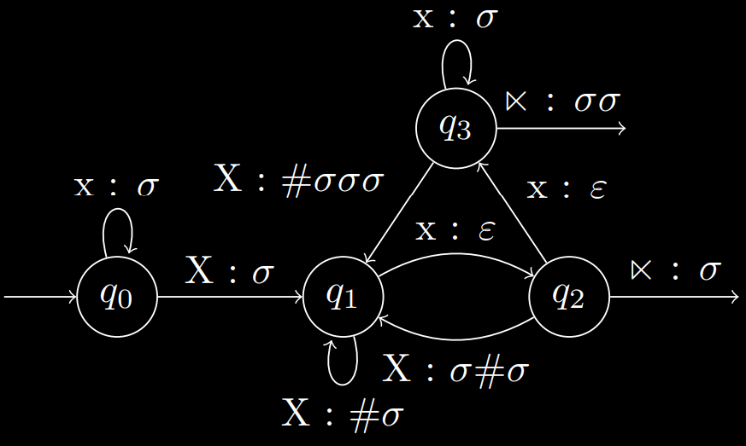
Irregular QI Non-rhythmic systems
X, Xx, xXx, xxXx, xxXxx, xxXxxx, xxXxxxx,...
Azkoitia Basque (Hualde 1998)
4 memory states
3 lookahead

Slide 40
Irregular QI Non-rhythmic systems
X, Xx, xXx, xxXx, xxXxx, xxxXxx, xxxxXxx,...
Içuã Tupi (Abrahamson 1968)
>=4 memory states, >=3 lookahead
Haven’t found a transducer yet; seems inordinately complicated

Slide 41
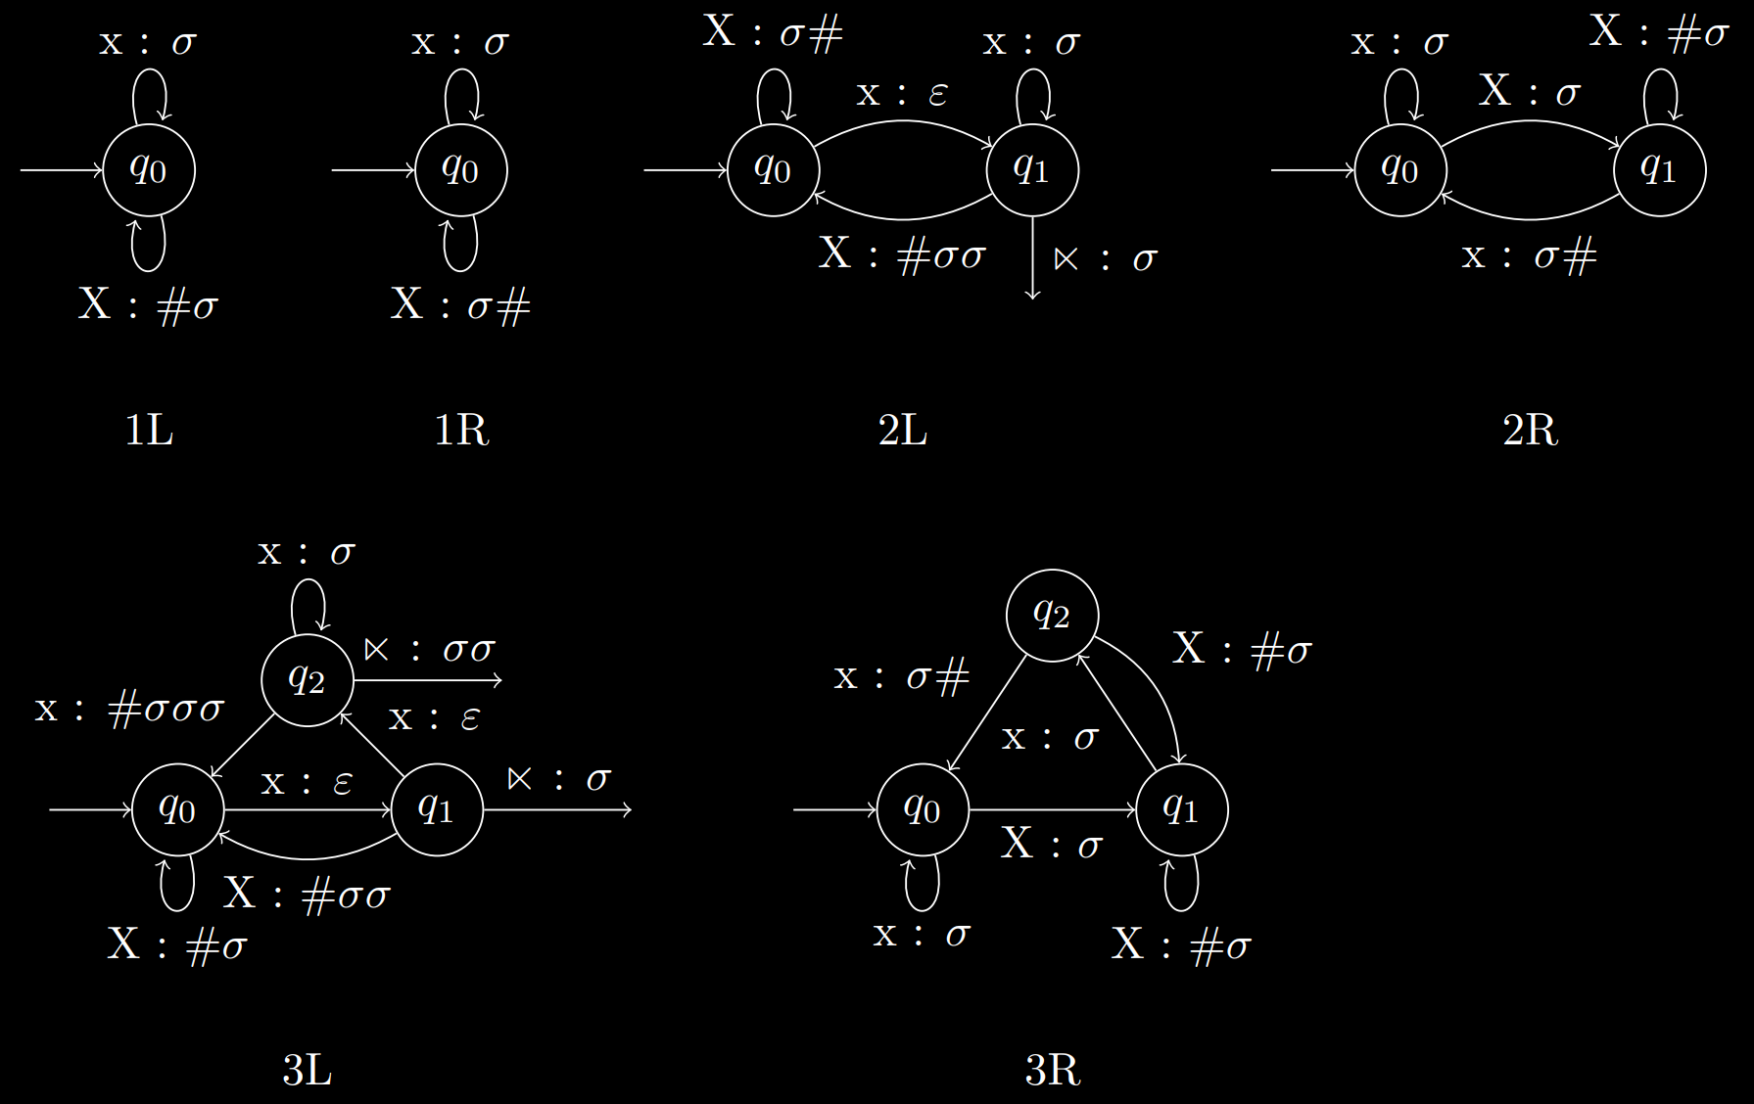
FSTs (QI)

Slide 42
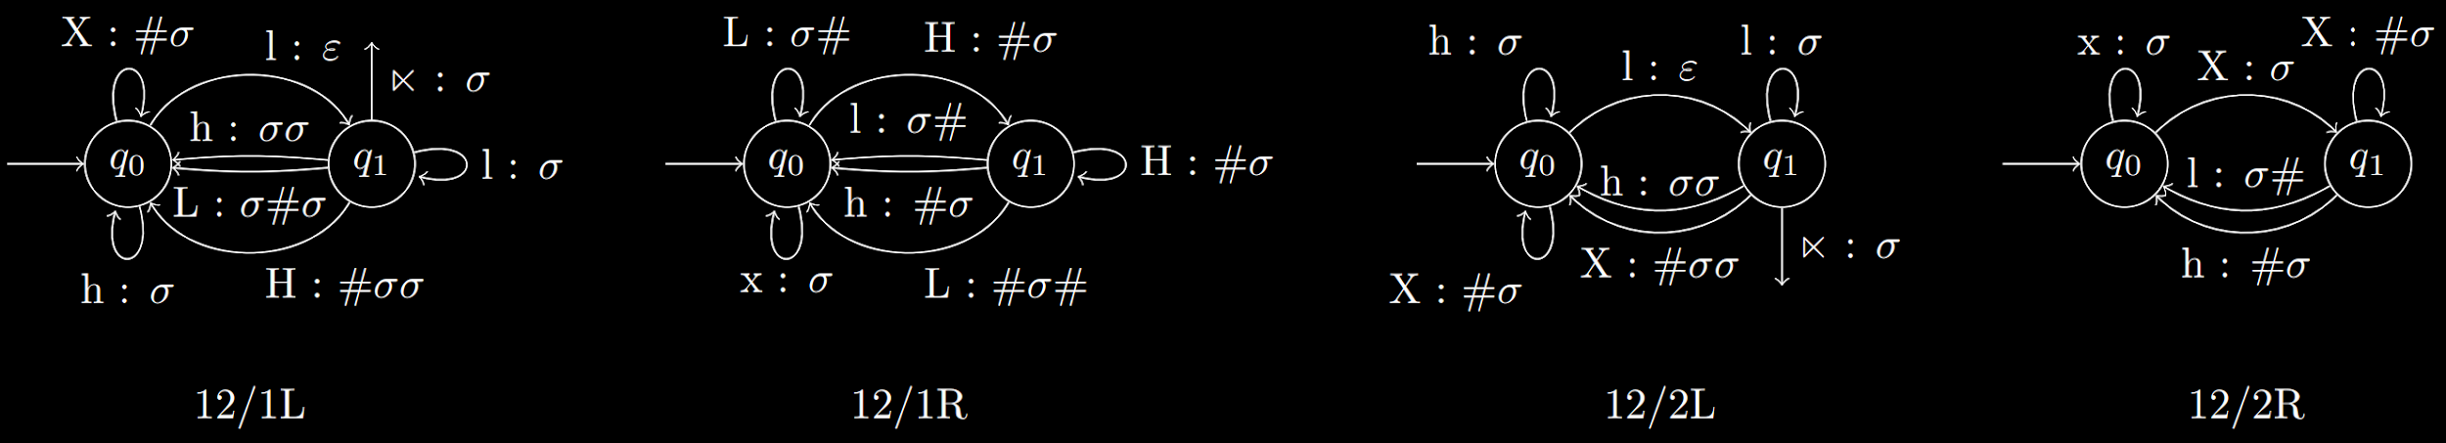
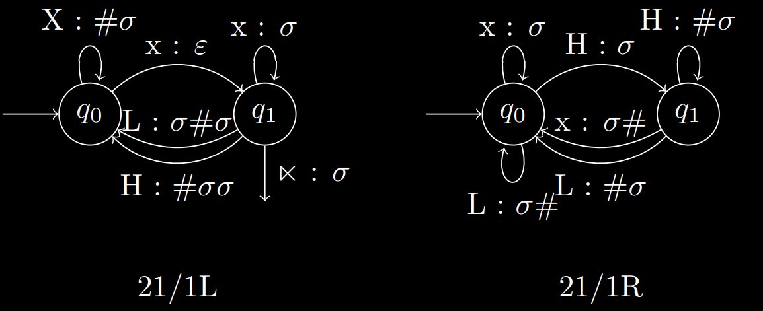
FSTs (QS, bounded)

Slide 43
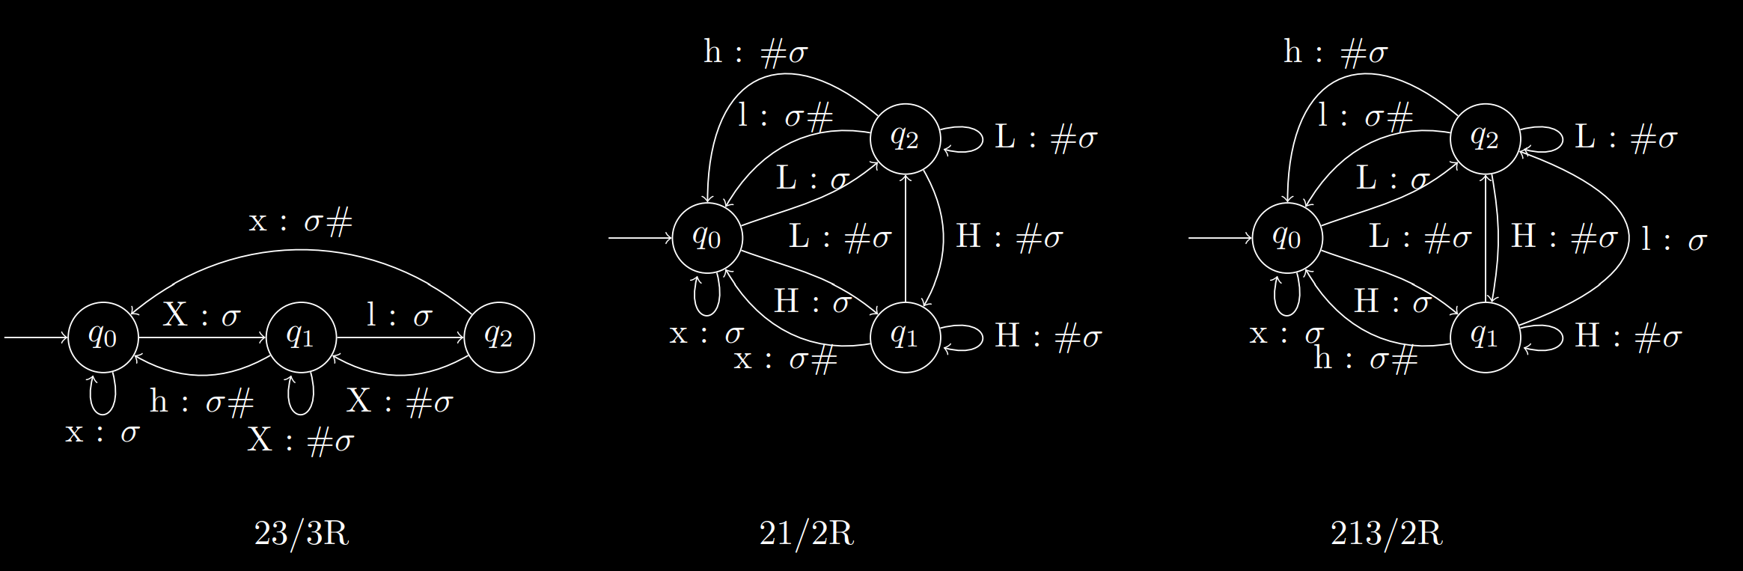
FSTs (QS, bounded, cont.)

Slide 44
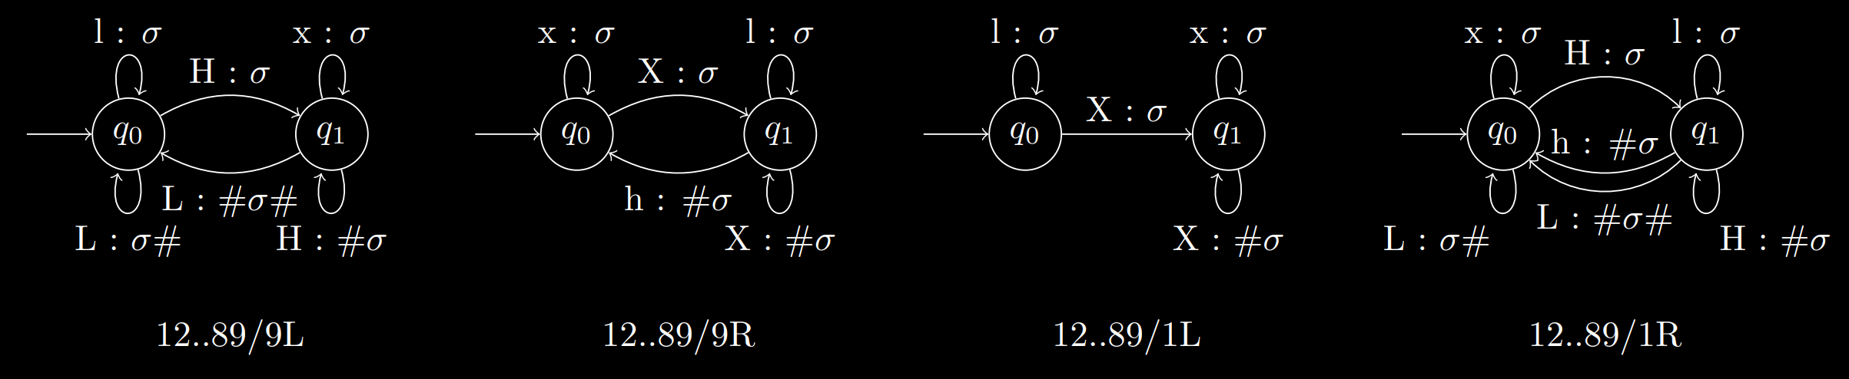
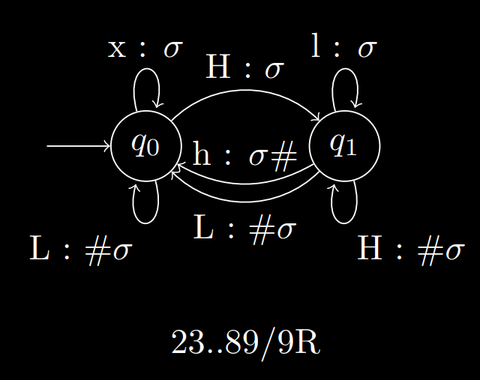
FSTs (QS, unbounded)

Slide 45
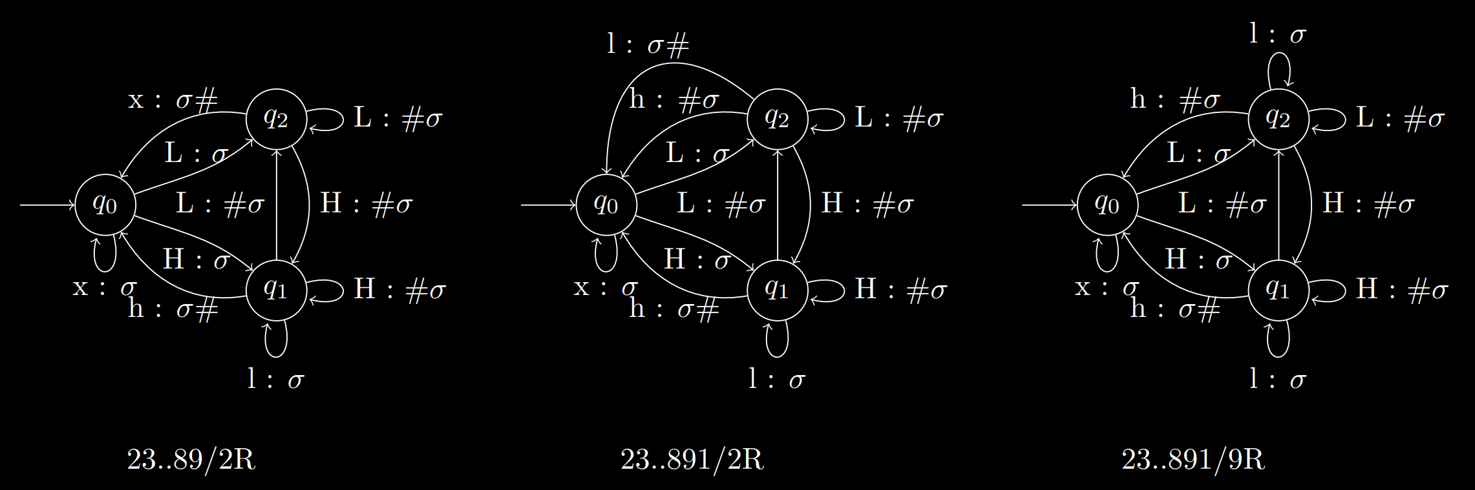
FSTs (QS, unbounded, cont.)

